Slide 1

Decoding Diabetes
Predictive Models and Insights Using Machine Learning
Professor: 안용길
Presents
Braian Plaku (브라이언 플라쿠)

Slide 2
Introduction
Diabetes is one of the most prevalent chronic diseases, affecting millions globally. This project aims to predict the likelihood of an individual having diabetes using the Behavioral Risk Factor Surveillance System (BRFSS) dataset from Kaggle.
The focus will be on understanding which factors contribute the most to diabetes risk and developing machine learning models to predict diabetes based on survey responses.
Dependent Variable Y: Diabetes_012
(0) no diabetes or only during pregnancy
(1) prediabetes
(2) diabetes
Dependent Variable X: 21 variables in the dataset
BMI
GenHlth
HighBP
HighChol
HeartDiseaseorAttack
Age
Education
Smoker
Veggies
NoDocbcCost
Income
Education
Fruits
PhysActivity
Stroke
PhysHlth
MentHlth
Sex
DiffWalk
AnyHealthcare, CholCheck

Slide 3


Digging deeper into the Data
Source:
CDC (Centers for Disease Control and Prevention) Behavioral Risk Factor Surveillance System, [LINK]
ANNUAL, uniform, state-specific data on preventive health practices and risk behaviors
Year 2011, extracted on Kaggle from CDC itself [LINK]
Original Data, in ‘csv’ format, 253,680 survey responses
Alex Teboul (Data Scientist), based on Building Risk Prediction Models for Type 2 Diabetes Using Machine Learning Techniques on Kaggle [LINK]
The data was cleaned into a useable format for machine learning alogrithms, reduction was made from 330 features (dependent variables) onto 21 variables
Link to his Notebook can be found here: [LINK]
Alex Teboul

Slide 4
Shaping the Data: Preprocessing & Preparation
Target Variable Binarization
Diabetes_012
(0) no diabetes or only during pregnancy
}
(0) no diabetes or only during pregnancy
(1) prediabetes
}
(1) prediabetes or diabetes
(2) diabetes
allows the models to focus on a simpler task!
Perform univariate logistic regression for each feature
after standardizing the data
Feature selection based on their p-values

Slide 5
Shaping the Data: Preprocessing & Preparation
Feature selection based on their p-values
 | coefficient | p-value | odds_ratio
HighBP | 0.780275 | <0.001 | 2.182072
Age | 0.579303 | <0.001 | 1.784794
DiffWalk | 0.552433 | <0.001 | 1.737476
PhysHlth | 0.444809 | <0.001 | 1.560193
GenHlth | 0.914087 | <0.001 | 2.494498
Cross-Validation
Using 5 splits
Data Undersampling
Using the RandomUnderSampler from imblearn-undersampling Python Library

Slide 6
Key Traits of the three chosen Models
three models implemented
Random Forest
Logistic Regression
Gradient Boosting
Builds multiple decision trees and combines their predictions
Provides feature importance, which tells us which factors are most important in predicting diabetes
Better suited for capturing complex patterns and interactions between features
Assigns weights (coefficients) to each feature, making it easy to interpret how each feature affects diabetes risk
Simple and more interpretable, but may not capture complex patterns as well as Random Forest
Builds an ensemble of weak learners, each focusing on correcting errors made by previous models.
Combines predictions in a sequential manner, leading to higher accuracy over time.
More complex than Logistic Regression.

Slide 7
Key Traits of the three chosen Models
three models implemented
Random Forest
Logistic Regression
Gradient Boosting
Splitted Training and Testing Sets
Built Random Forest Model
estimating 100 trees
Fit & trained the model
Predicted the data
Evaluated the model
Analyzed Feature Importance
Plotted the results visually
Splitted Training and Testing Sets
Built Logic Regression Model
with 1000 iterations
Fit & trained the model
Predicted the data
Evaluated the model
Plotted the results visually
Splitted Training and Testing Sets
Built Gradient Boosting Model
using 100 estimators and a learning rate of 0.1
Fit & trained the model
Predicted the data
Evaluated the model
Analyzed Feature Importance
Plotted the results visually

Slide 8
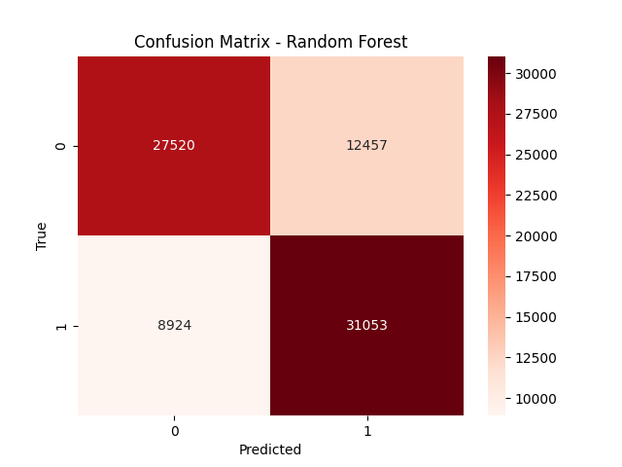
Outcome Review
Random Forest: Confusion Matrix
Breakdown of true and false positives and negatives
Correctly predicted
27,520 negatives
31,053 positives
Incorrectly flagged
8,924 negatives
12,457 positives

Slide 9
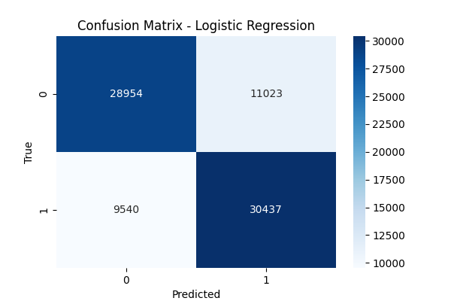
Outcome Review
Logistic Regression: Confusion Matrix
Breakdown of true and false positives and negatives
Correctly predicted
28,954 negatives
30,437 positives
Incorrectly flagged
9,540 negatives
11,023 positives

Slide 10
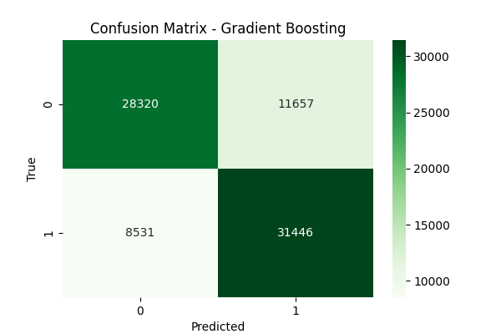
Outcome Review
Gradient Boosting: Confusion Matrix
Breakdown of true and false positives and negatives
Correctly predicted
28,320 negatives
31,446 positives
Incorrectly flagged
8,531 negatives
11,657 positives

Slide 11
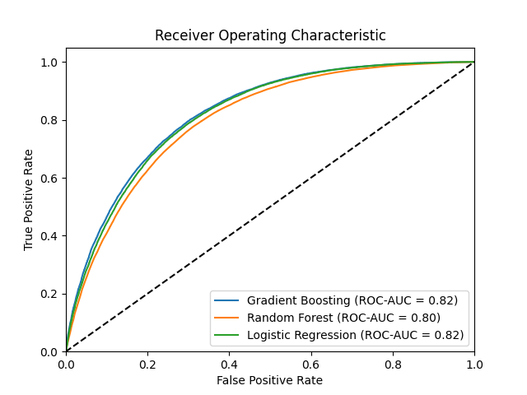
Outcome Review
Conclusion: Model Evaluation
Random Forest:
Lower accuracy (73.2%)
Good feature importance
Low precision (71.3%)
Logistic Regression:
Higher accuracy (74.2%)
More interpretable
Slightly better precision (73.4%)
Gradient Boosting:
Best accuracy (74.7%)
Best ROC-AUC (82.4%)
Good precision (73.0%)
 | Acccuracy | Precision | ROC-AUC
Random Forest | 73,2% | 71,3% | 80,2%
Logistic Regression | 74,2% | 73,4% | 81,8%
Gradient Boosting | 74,7% | 73,0% | 82,4%

Slide 12
Literature
Literature
From the Web
Dataset:
Centers for Disease Control and Prevention:
https://www.cdc.gov/brfss/annual_data/annual_data.htm
Kaggle Datasets:
https://www.kaggle.com/datasets/cdc/behavioral-risk-factor-surveillance-system
https://www.kaggle.com/datasets/alexteboul/diabetes-health-indicators-dataset
Material:
Statistical Learning with Python, Stanford Online
https://www.youtube.com/playlist?list=PLoROMvodv4rPP6braWoRt5UCXYZ71GZIQ
Python Libraries:
https://scikit-learn.org/
https://imbalanced-learn.org/stable/under_sampling.html
More on Random Forest:
https://www.geeksforgeeks.org/random-forest-algorithm-in-machine-learning/

Slide 13
Thank you
for your attention!

